Slide 1
Text-to-Image Generation
2023_09_20_9차 세미나

Slide 2
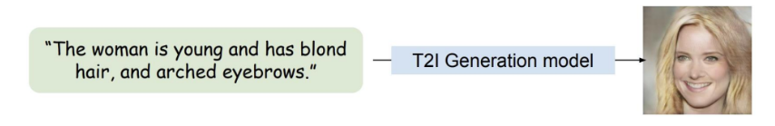
Text-to-Image Generation
Dataset
Multimodal CelebA-HQ
1장의 Image 당 4개의 text caption 존재
총 개수 30,000장 = train 24,000장 + test 6,000장
Model architecture
Conditioning Augmentation network(CANet)
Three stage GANs
Loss with contrastive learning
Restriction
반드시 Google Colab 사용, 추가적인 train data 사용 불가능

Slide 3
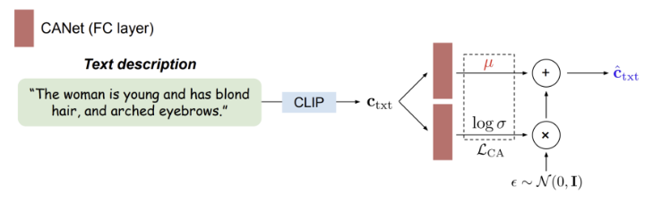
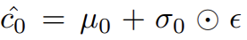
Conditioning Augmentation network
Input: Text embedding
Outputs: Condition vector, mu, sigma

Slide 4
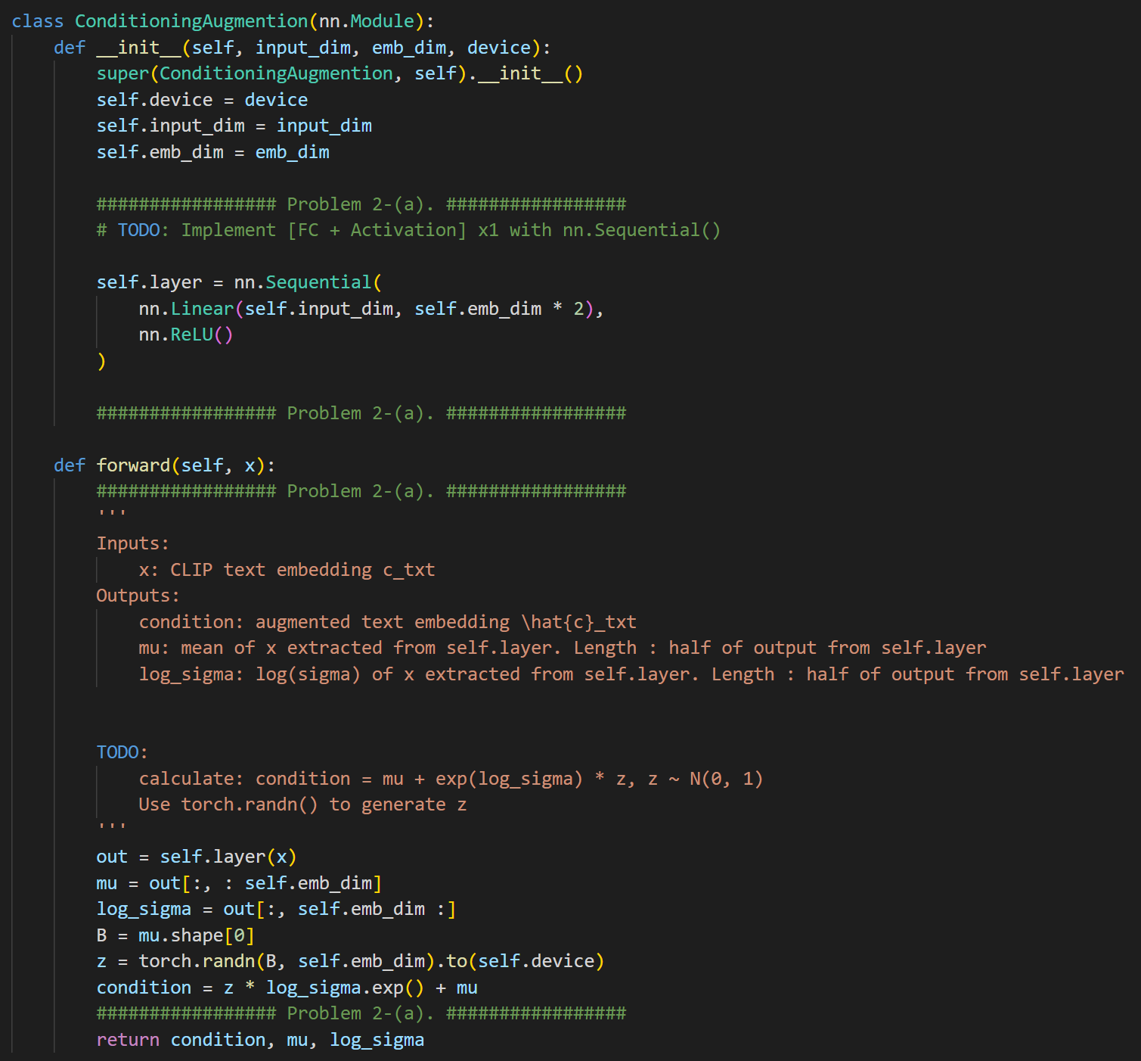
Conditioning Augmentation network

Slide 5
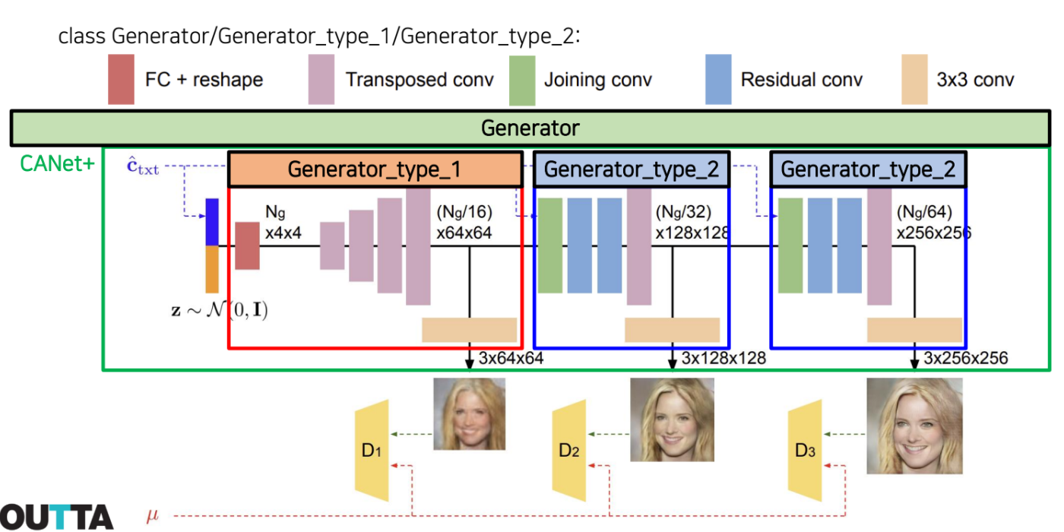
Generator
Input: Condition vector
Outputs: fake images

Slide 6
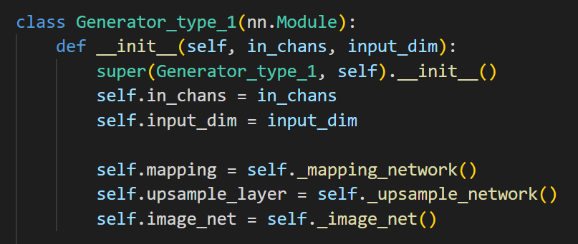
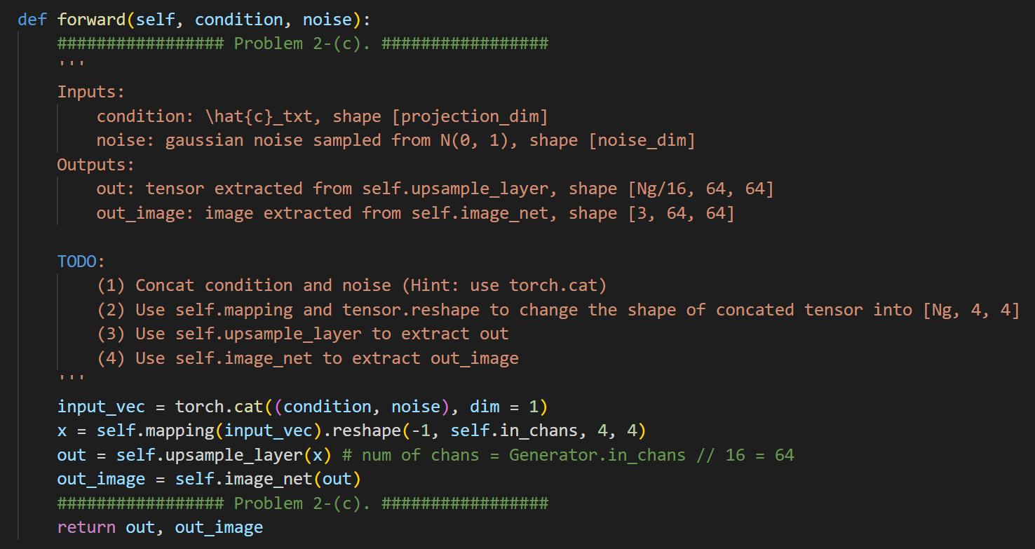
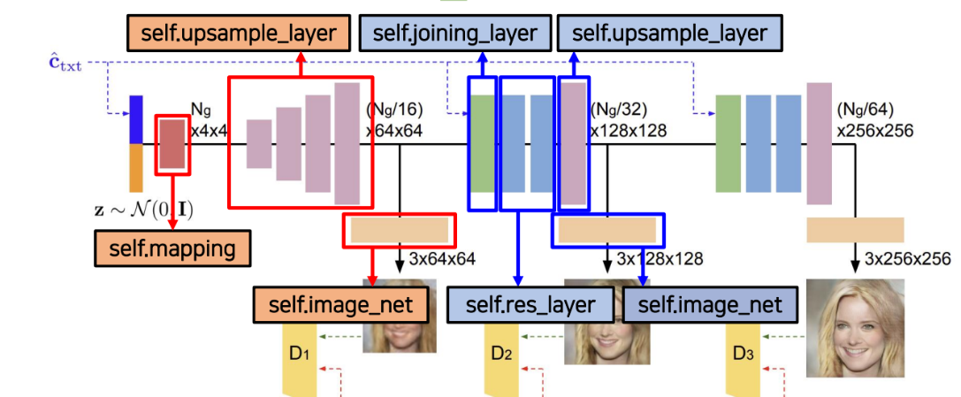
Generator_type_1 code

Slide 7
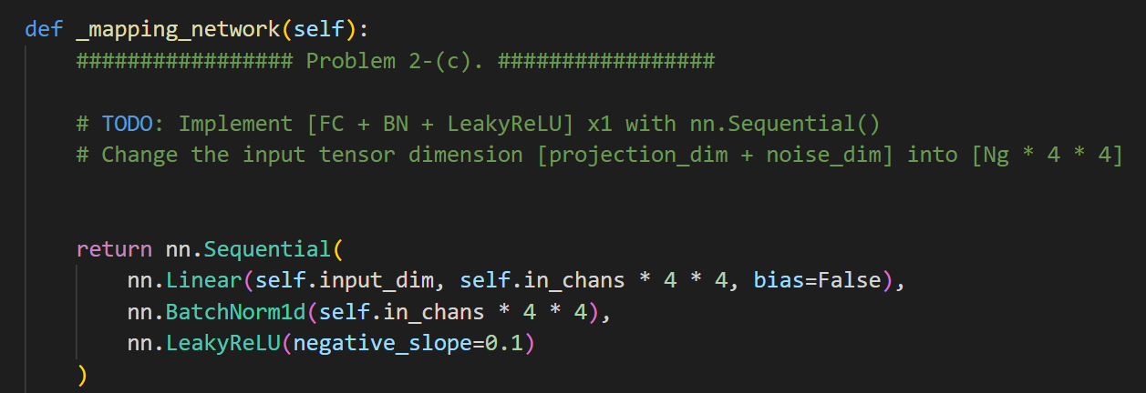
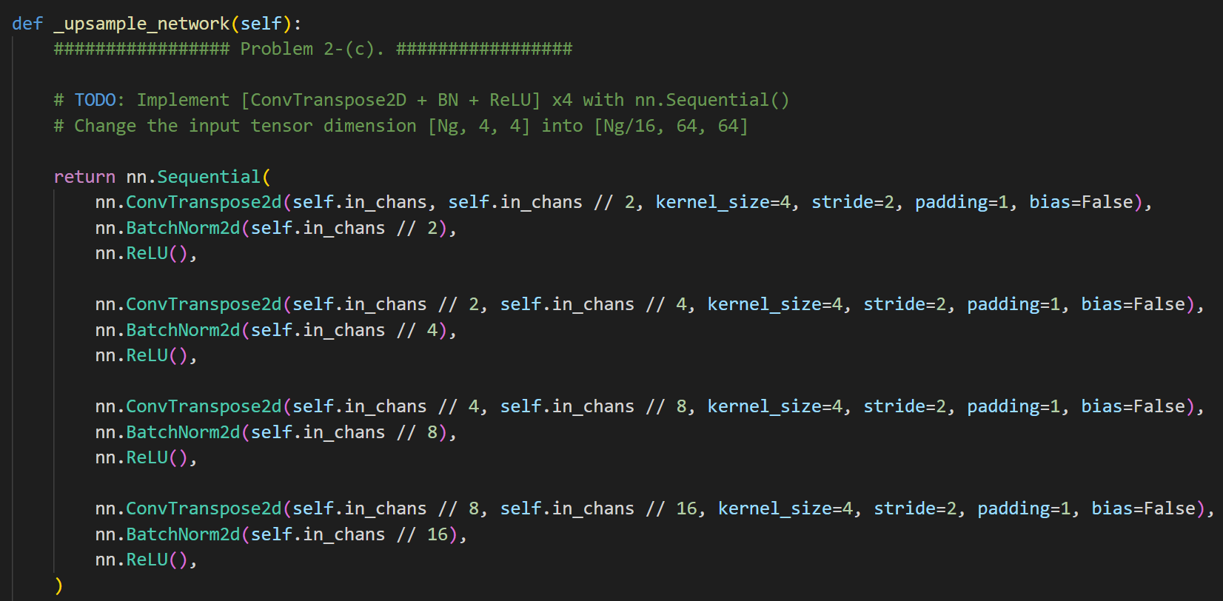
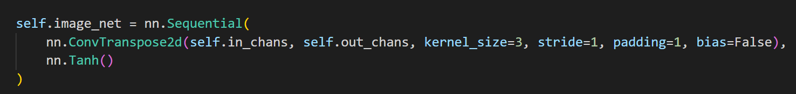
Generator_type_1 code

Slide 8
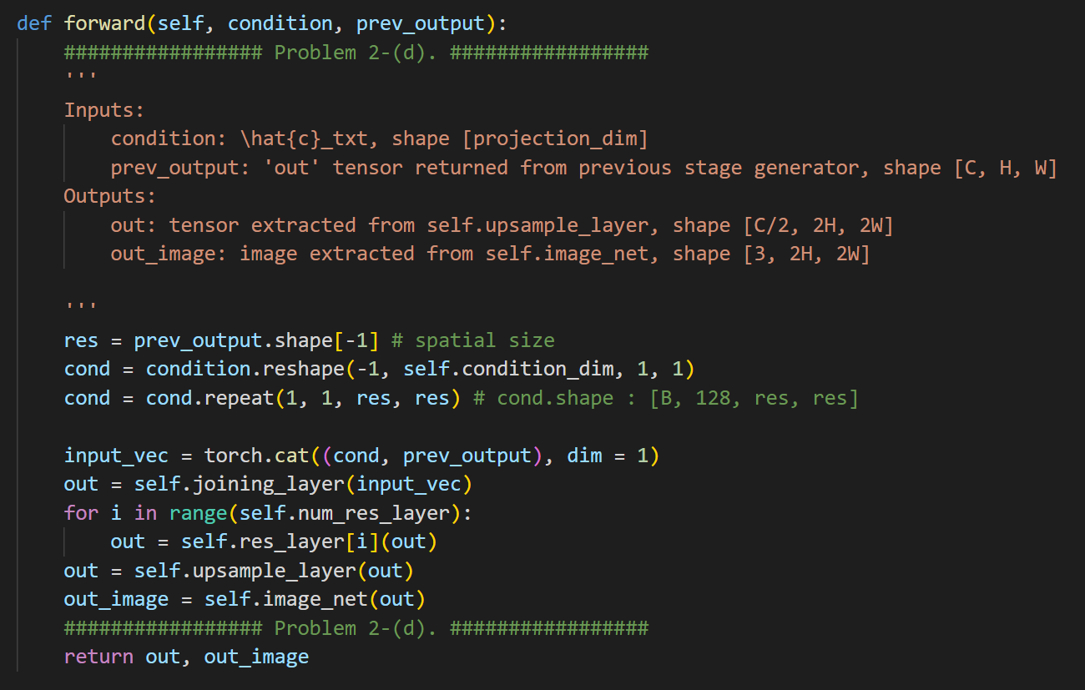
Generator_type_2 code

Slide 9
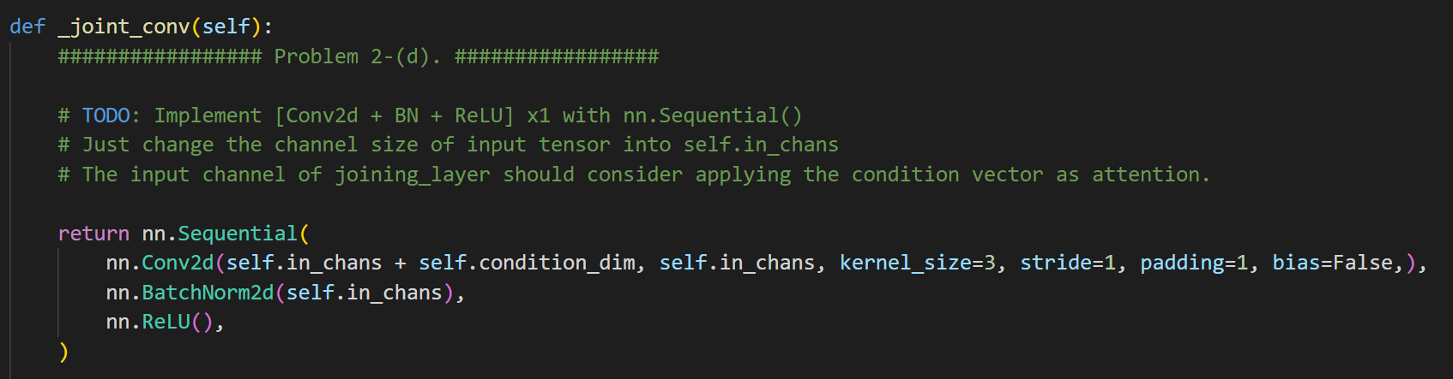
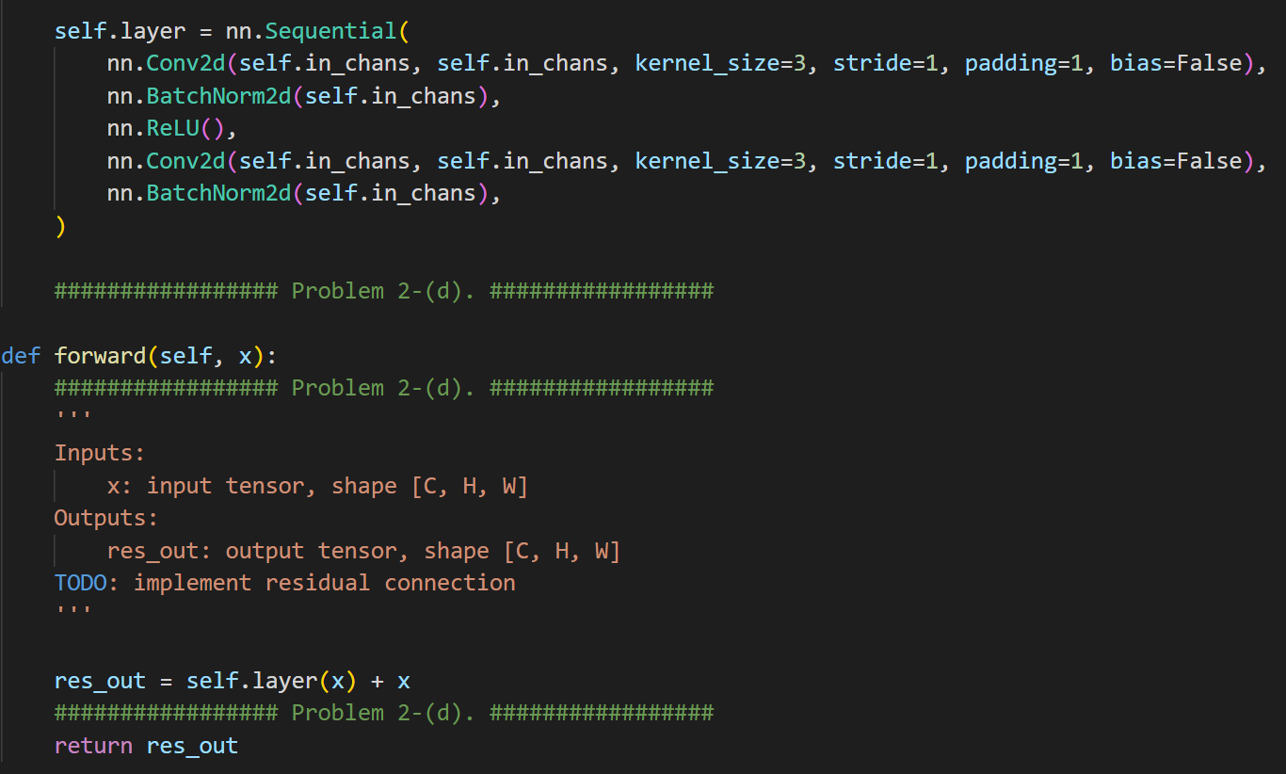
Generator_type_2 code

Slide 10
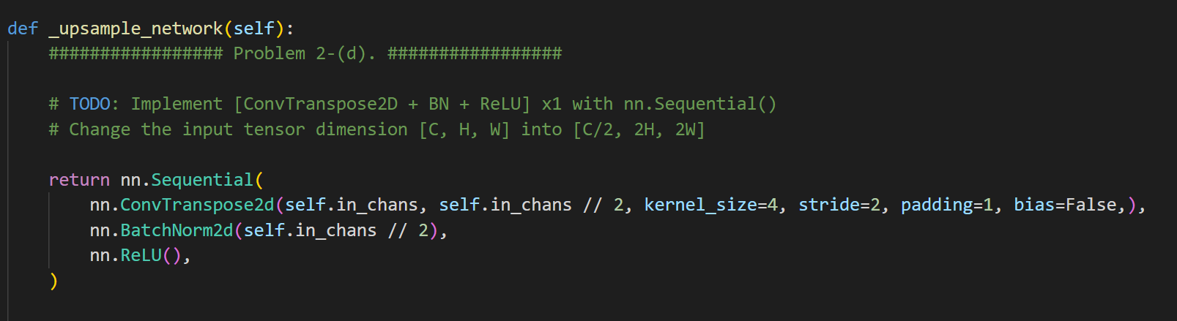
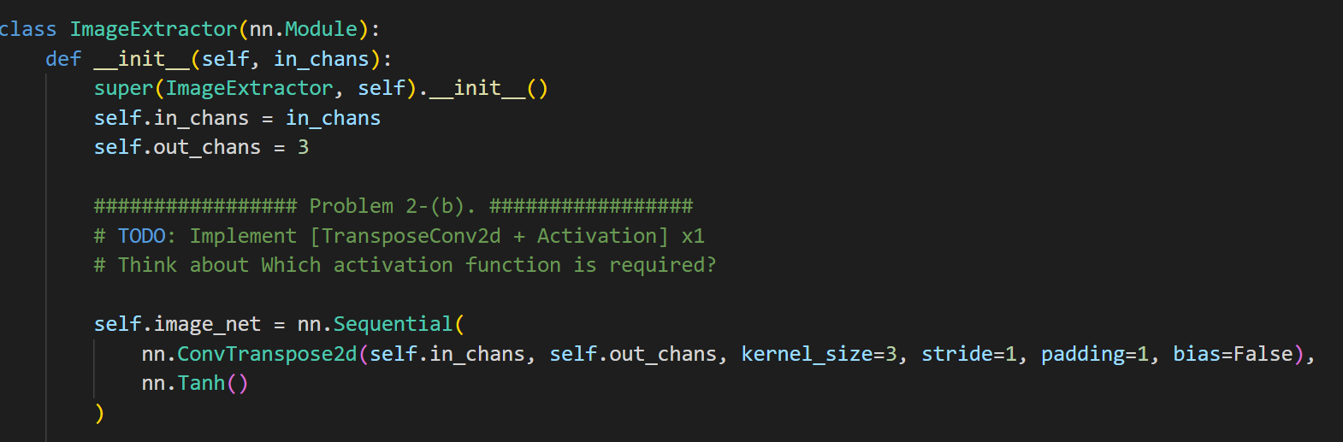
Generator_type_2 code

Slide 11
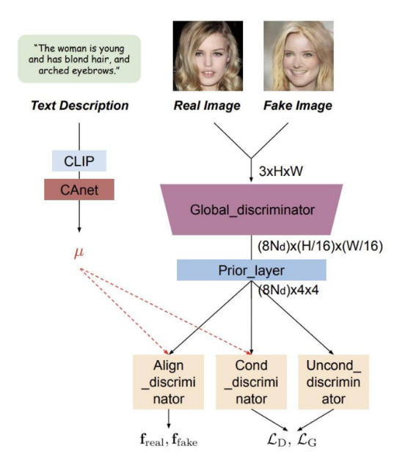
Discriminator
Unconditional Discriminator
Conditional Discriminator
Align Discriminator
Contrastive loss 계산을 위해 사용
Input: fake/ real image, condition vector
Outputs: Prediction result, align_out_result

Slide 12
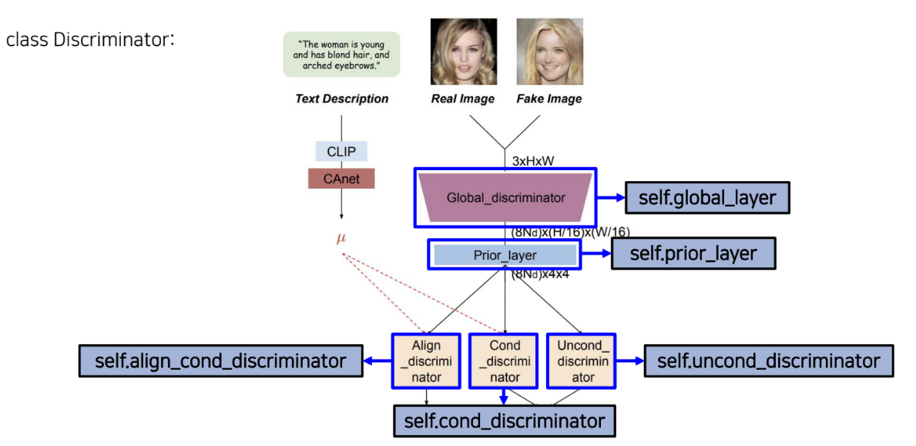
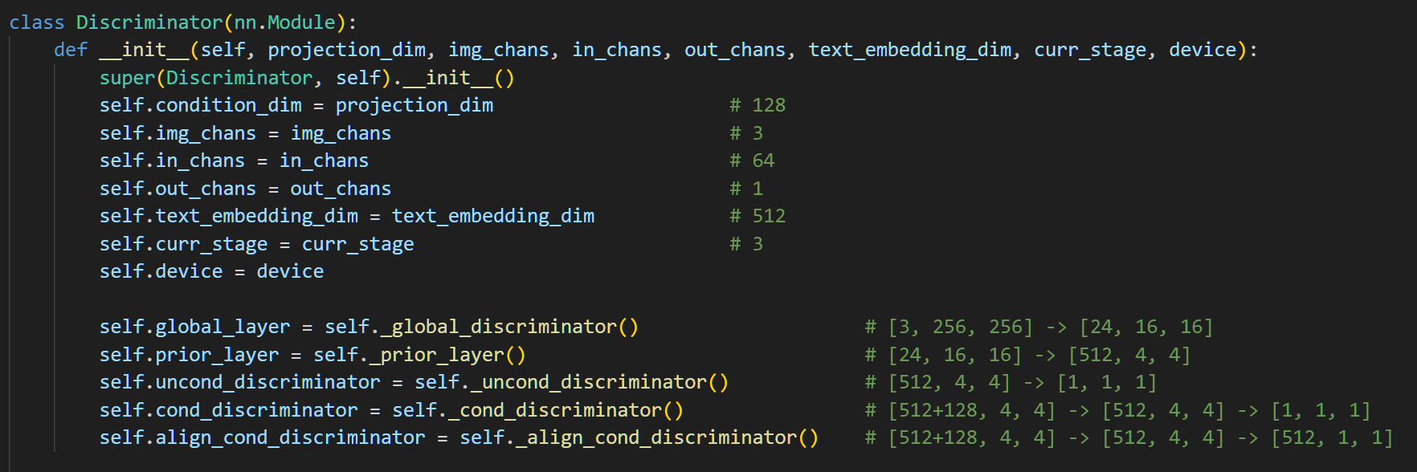
Discriminator

Slide 13
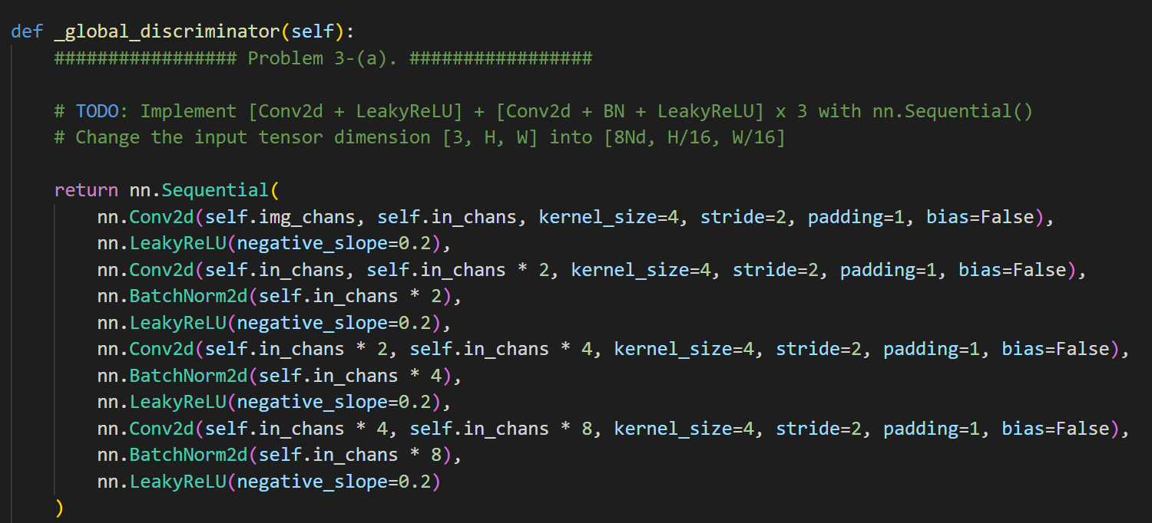
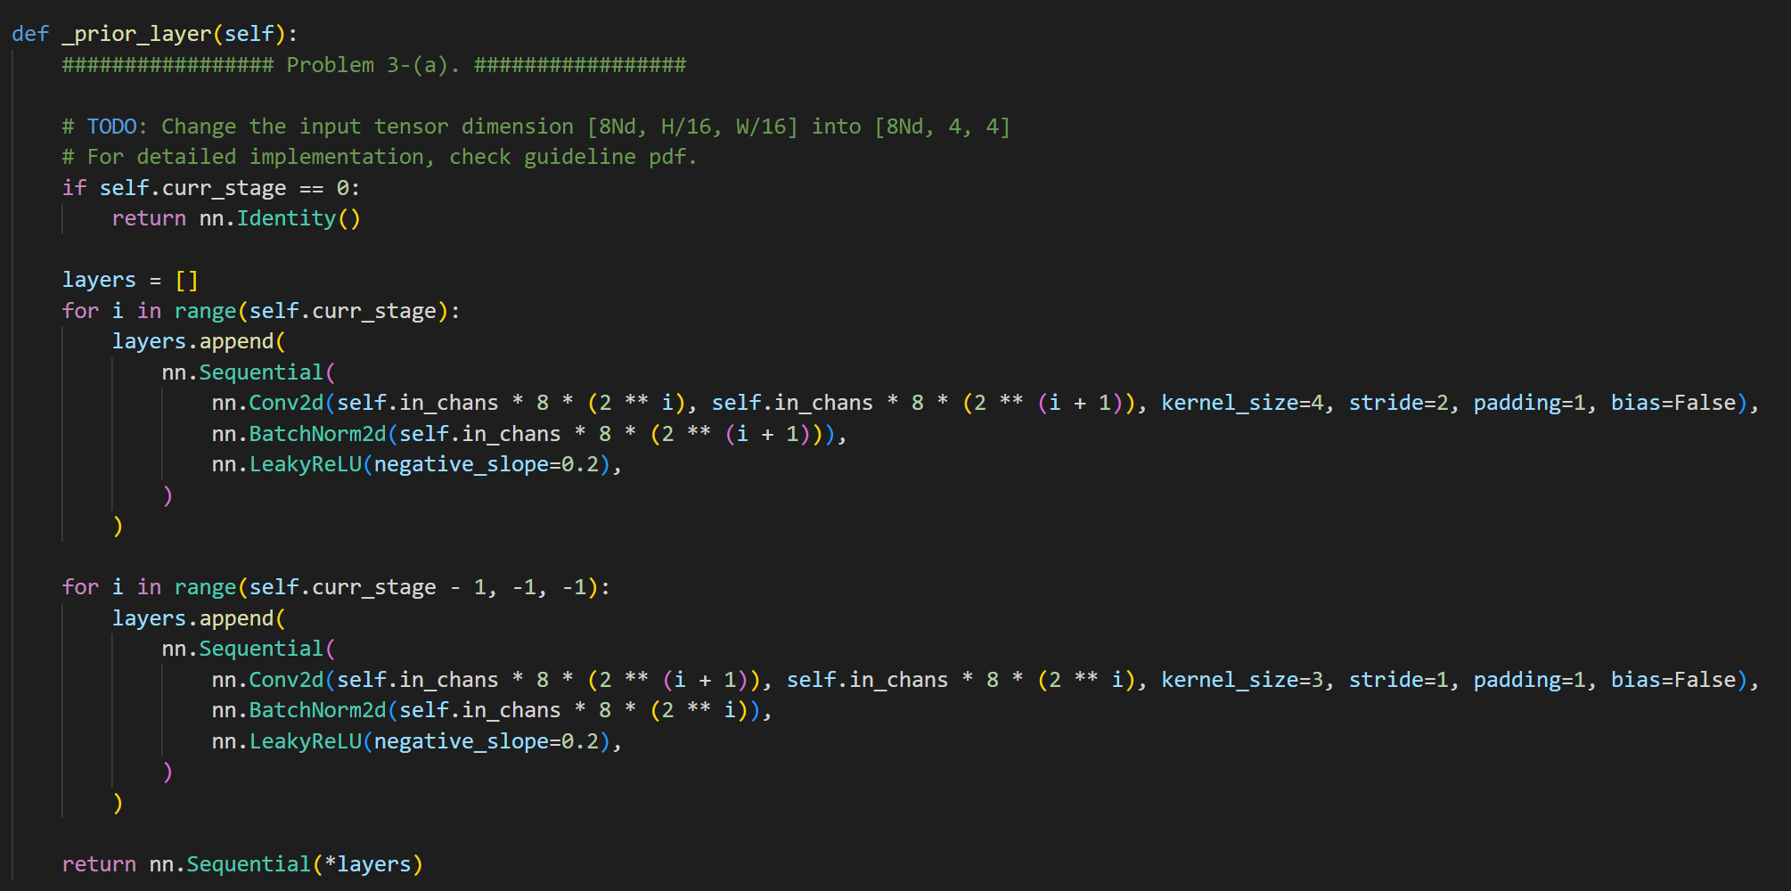
Discriminator

Slide 14
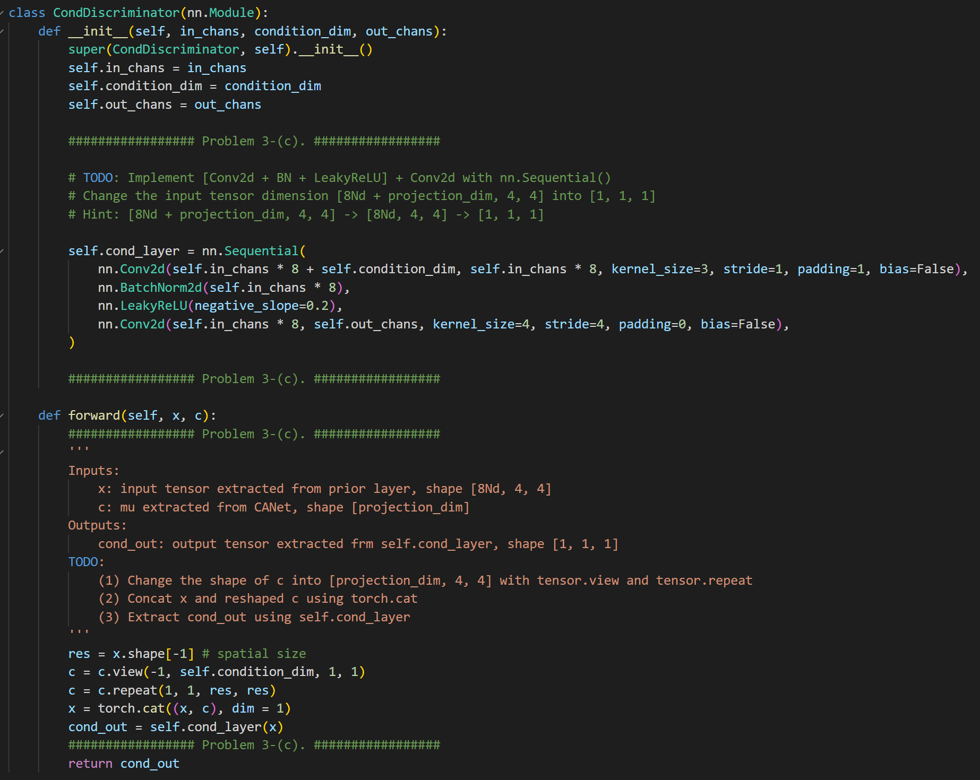
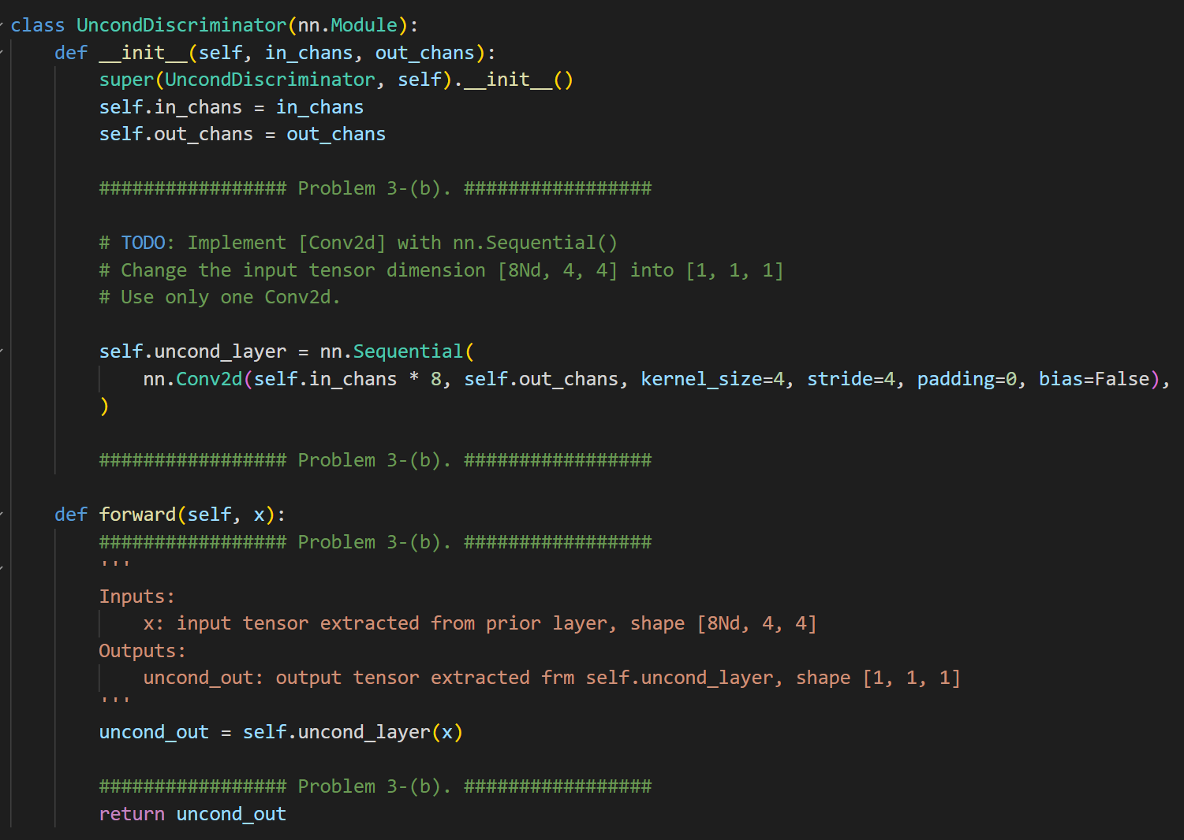
Discriminator
Unconditional Discriminator
conditional Discriminator

Slide 15
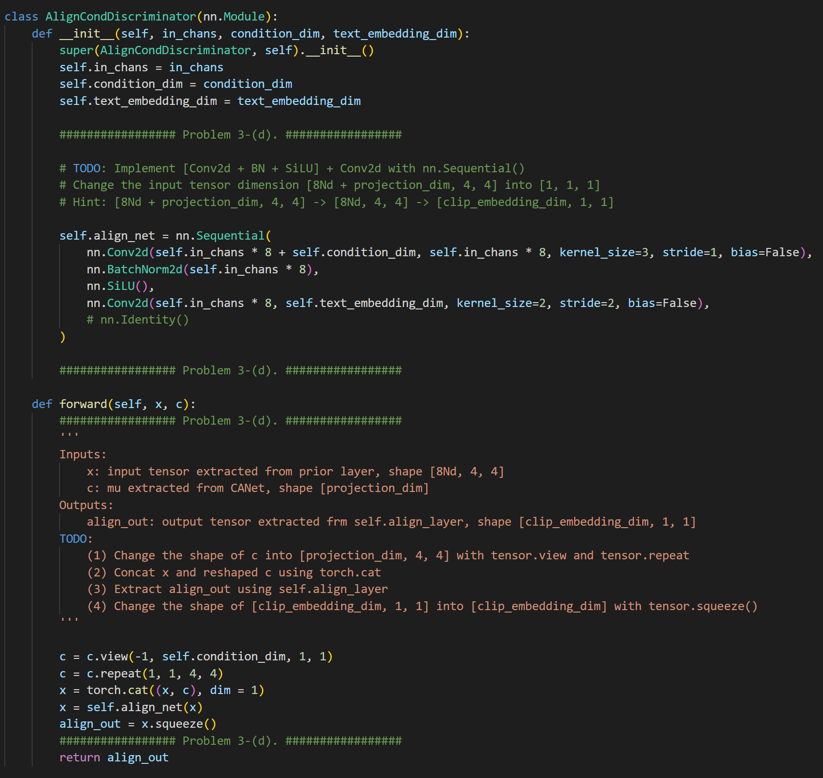
Discriminator
Ailgn Discriminator

Slide 16
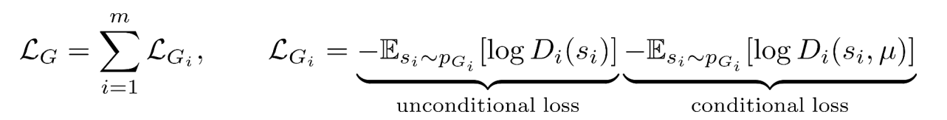
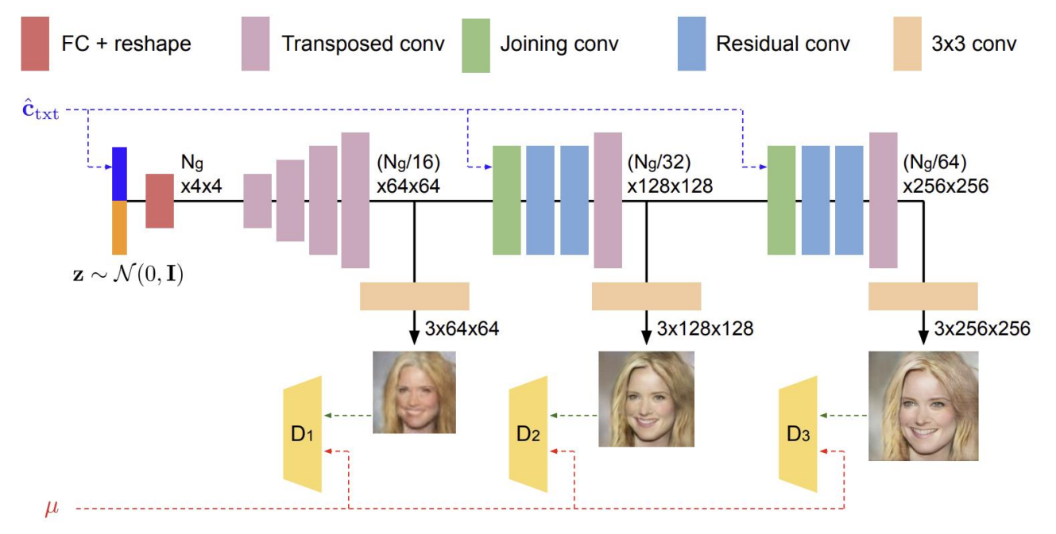
Generator Loss
Unconditional loss – 생성된 image가 진짜, 가짜인지?
Conditional loss – 생성된 image와 condition의 일치 여부
Loss function

Slide 17
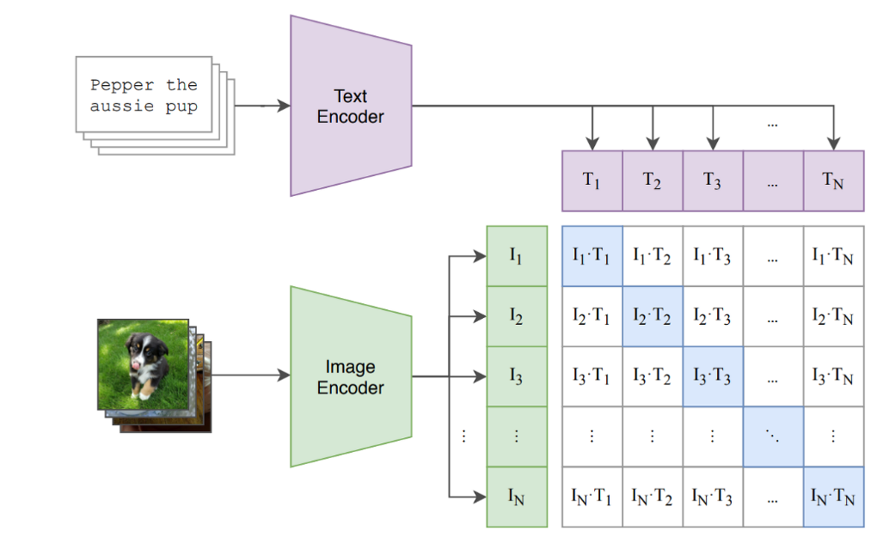
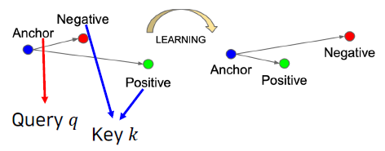
Contrastive Learning
데이터 샘플 간의 유사도 비교를 통해 Representation Learning
Positive pair의 feature representation은 거리를 좁히고
Negative pair의 feature representation은 거리가 멀어지도록 Representation Learning

Slide 18
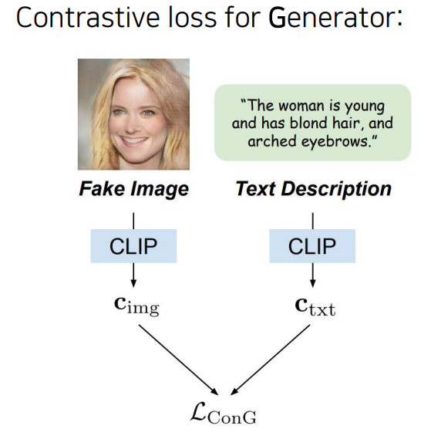
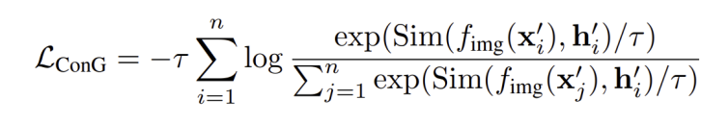
Loss with Contrastive Learning
Generator가 생성한 이미지와 주어진 txt정보가 얼마나 잘 맞는지?
Target image feature
나머지 image feature
Target image의 condition txt feature

Slide 19
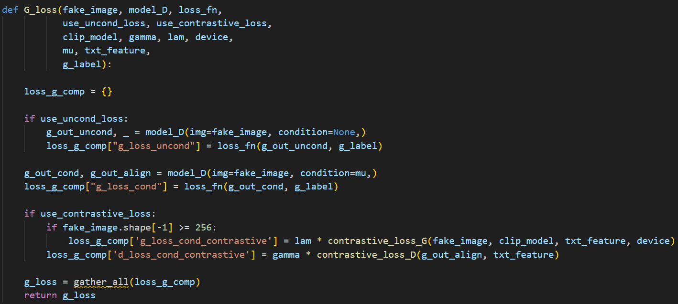
Loss with Contrastive Learning
G_Loss
Unconditional Loss + Conditional Loss + Contrastive Loss

Slide 20
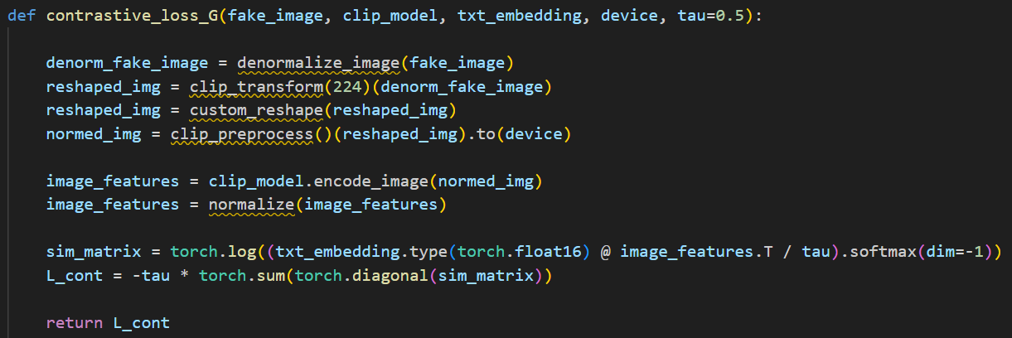
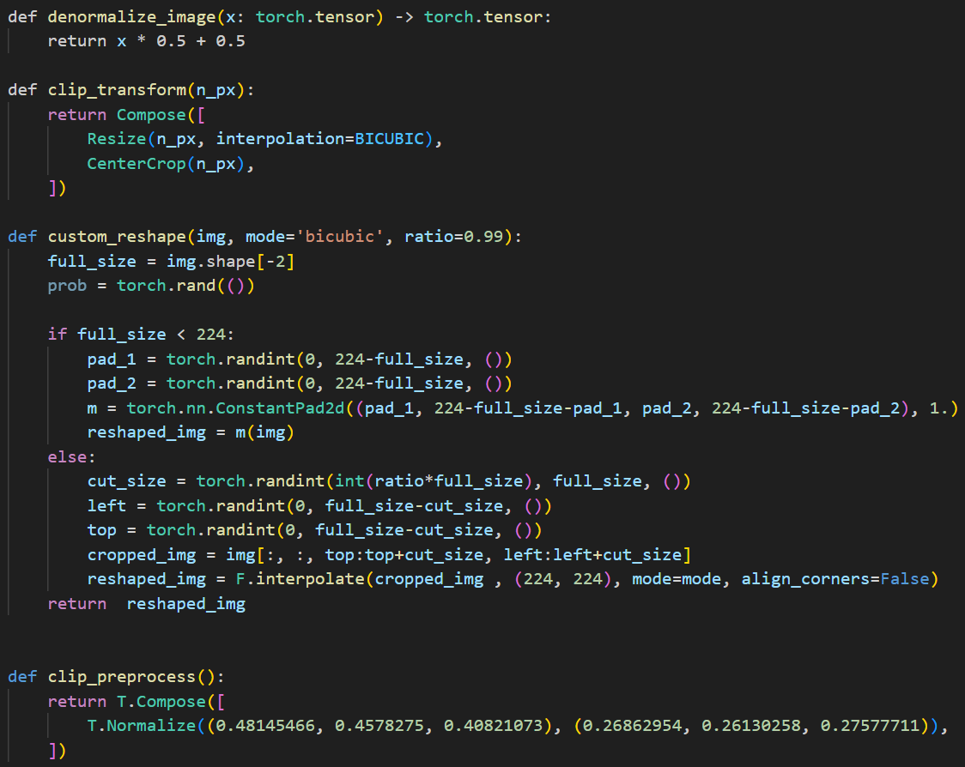
Loss with Contrastive Learning
G_Loss
Unconditional Loss + Conditional Loss + Contrastive Loss

Slide 21
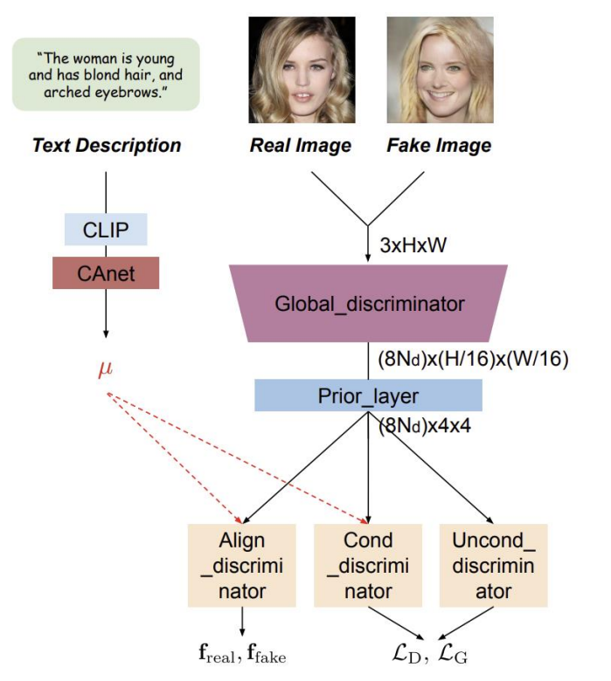
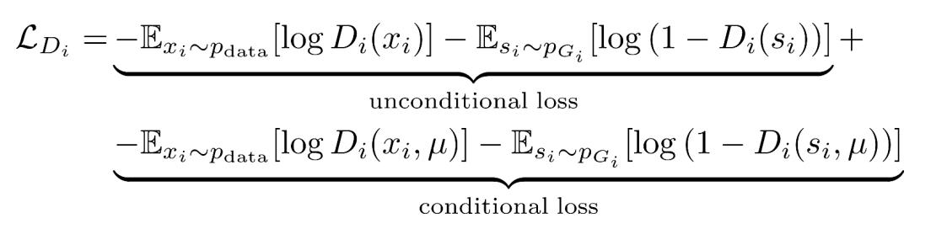
Discriminator Loss
Loss function
Unconditional loss – 생성된 image가 진짜, 가짜인지?
Conditional loss – 생성된 image와 condition의 일치 여부

Slide 22
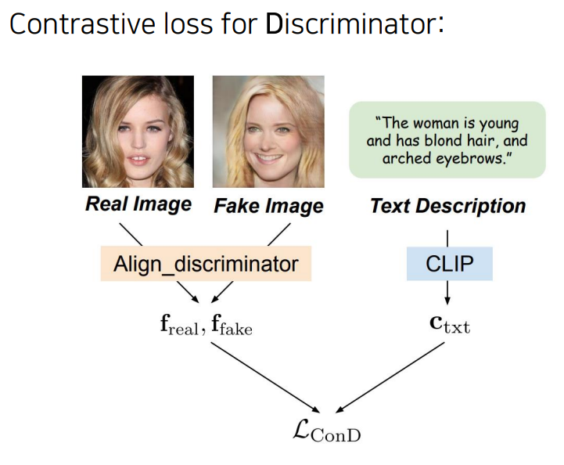
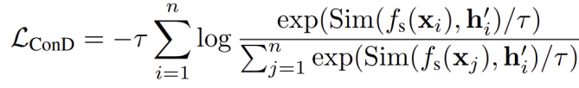
Loss with Contrastive Learning
Generator가 생성한 이미지와 주어진 txt정보가 얼마나 잘 맞는지 평가하기 위한 Loss
Target image의 embedding feature
나머지 image의 embedding feature
Target image의 condition txt feature

Slide 23
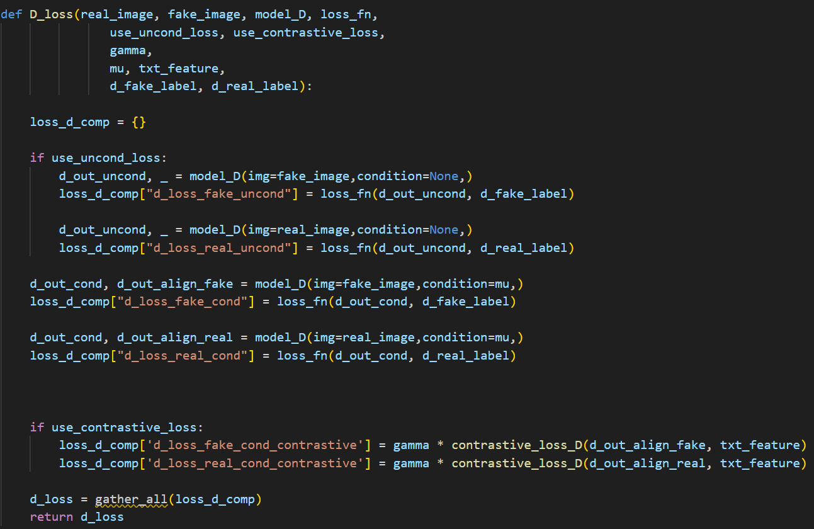
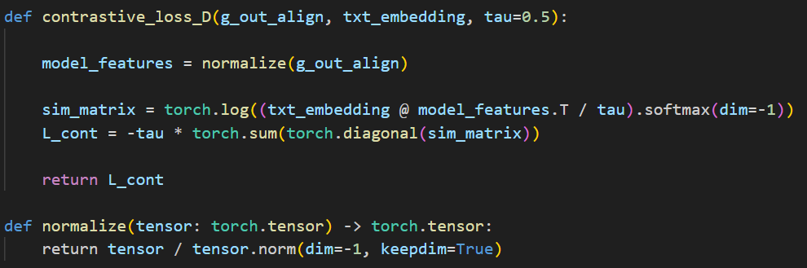
Loss with Contrastive Learning
D_Loss
Unconditional Loss + Conditional Loss + Contrastive Loss

Slide 24
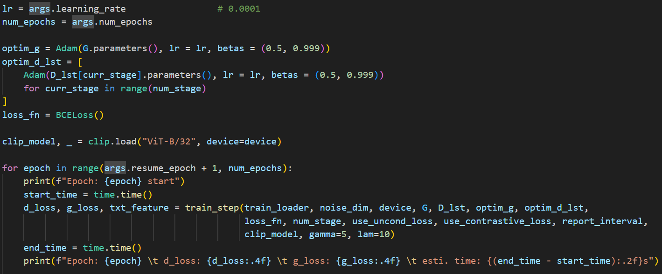
Train

Slide 25
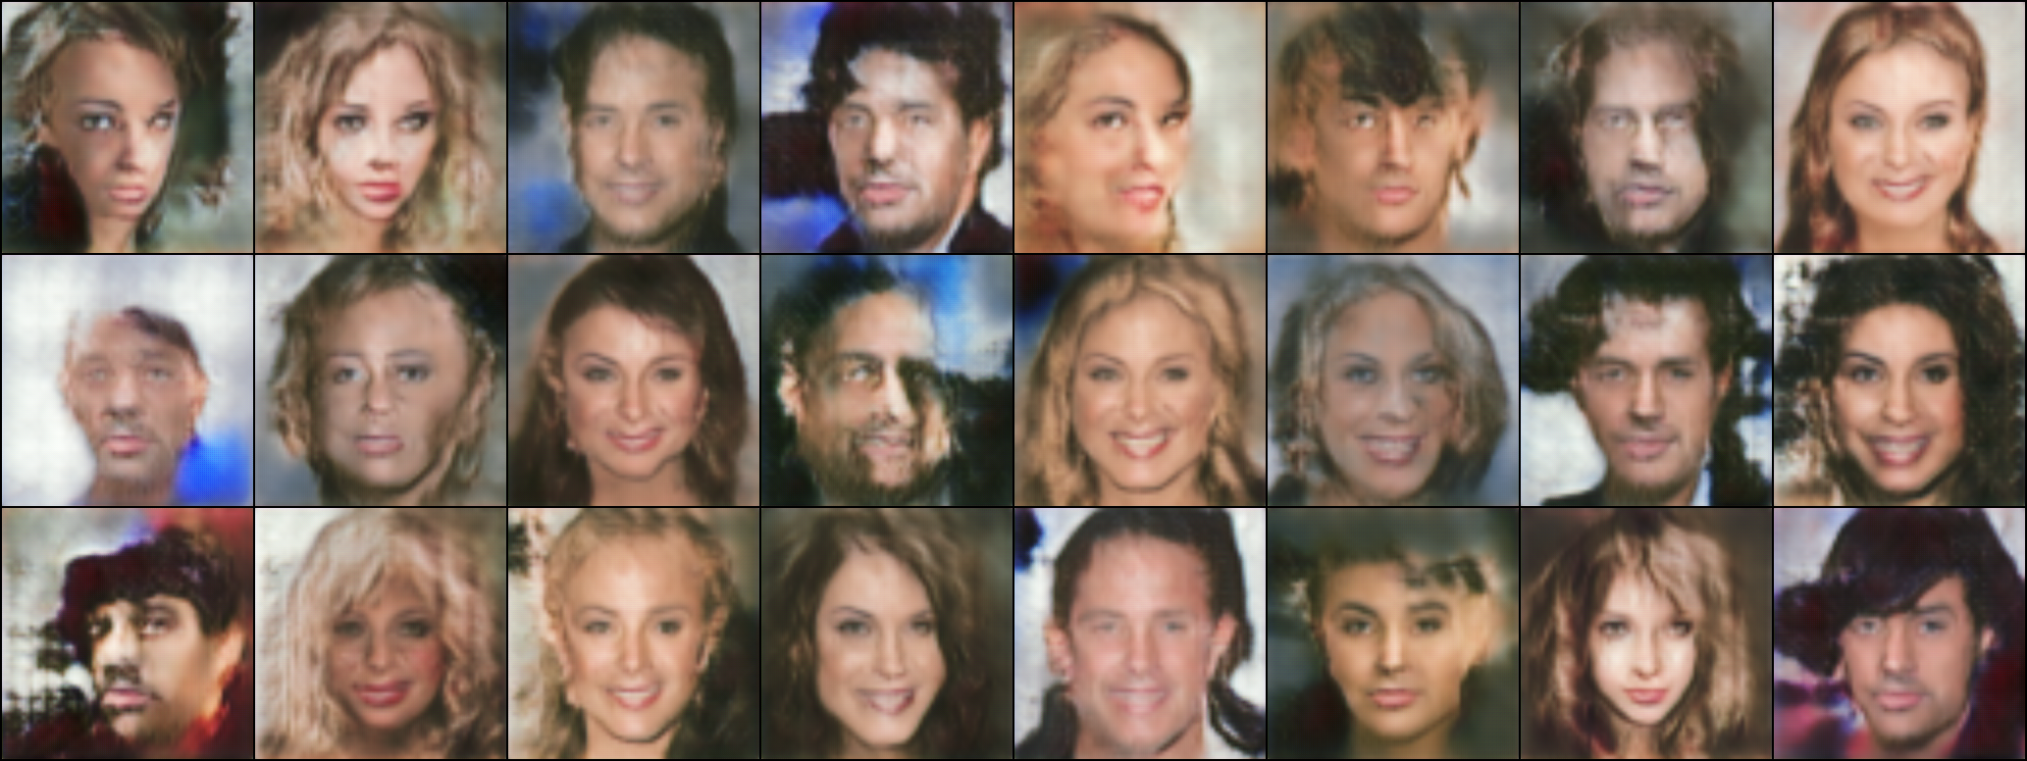
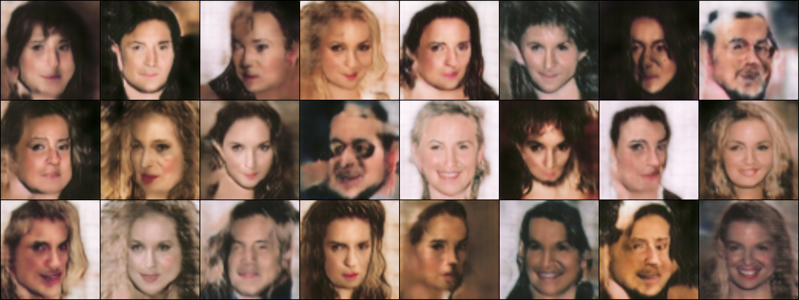
결과

Slide 26
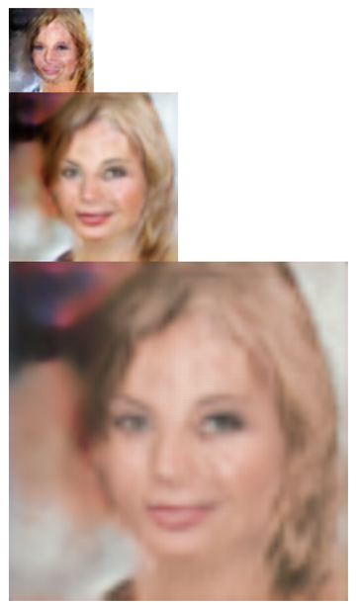
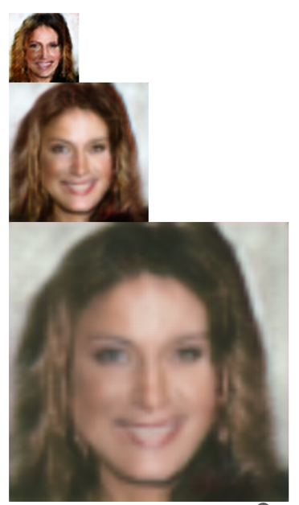
결과
The woman in young and has blond hair, and arched eyebrows.
The woman has wavy hair,
and mouth slightly open

Slide 27
감사합니다

